Slide 1
Exam 2 Database
MentorShip

Slide 2
1. Topic 2. Database

Slide 3
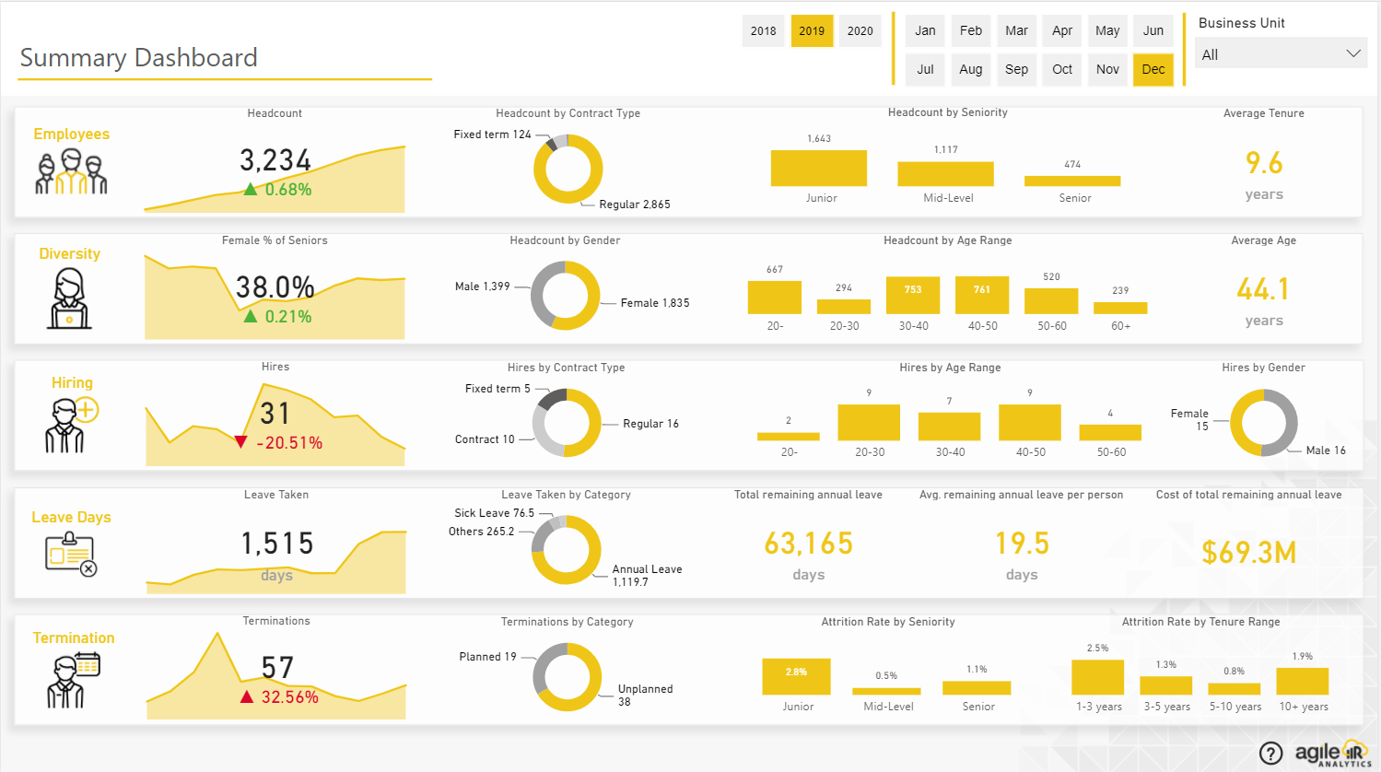
1. Topic

Slide 4
1.Topic
There are active year, month, and business filters applied across the entire query.
Main items on the page.

Slide 5
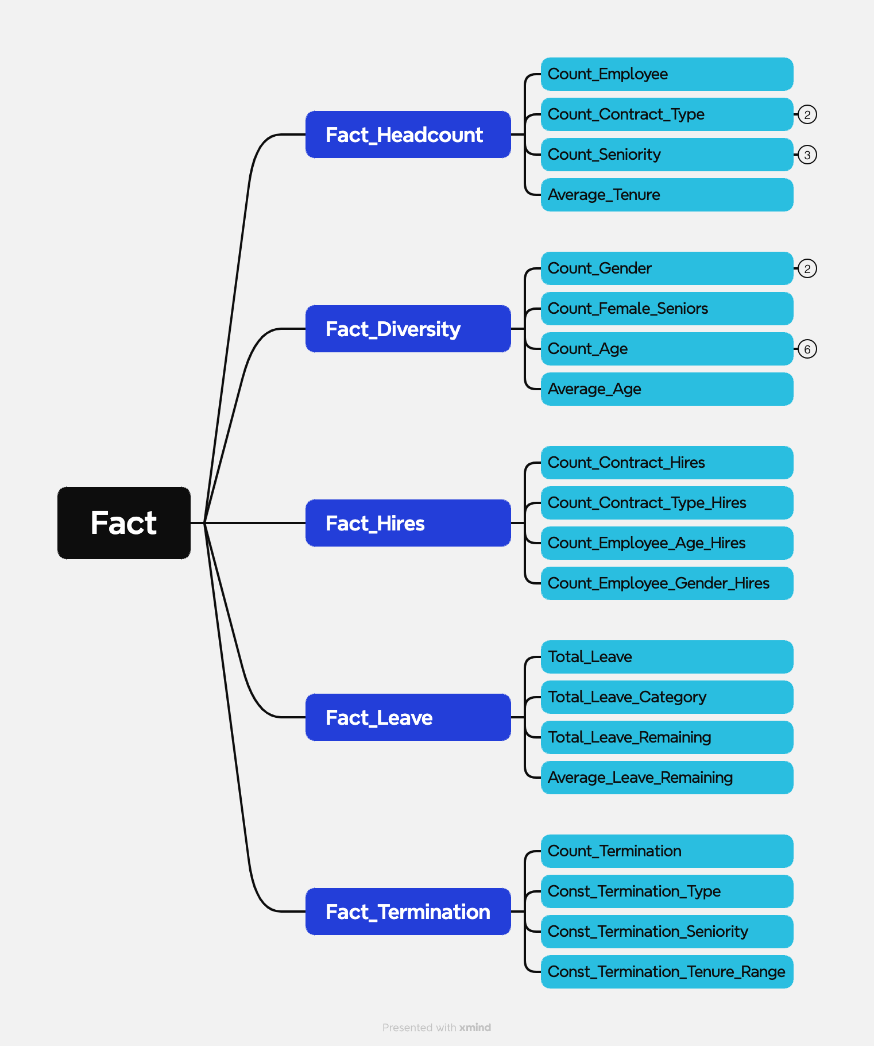
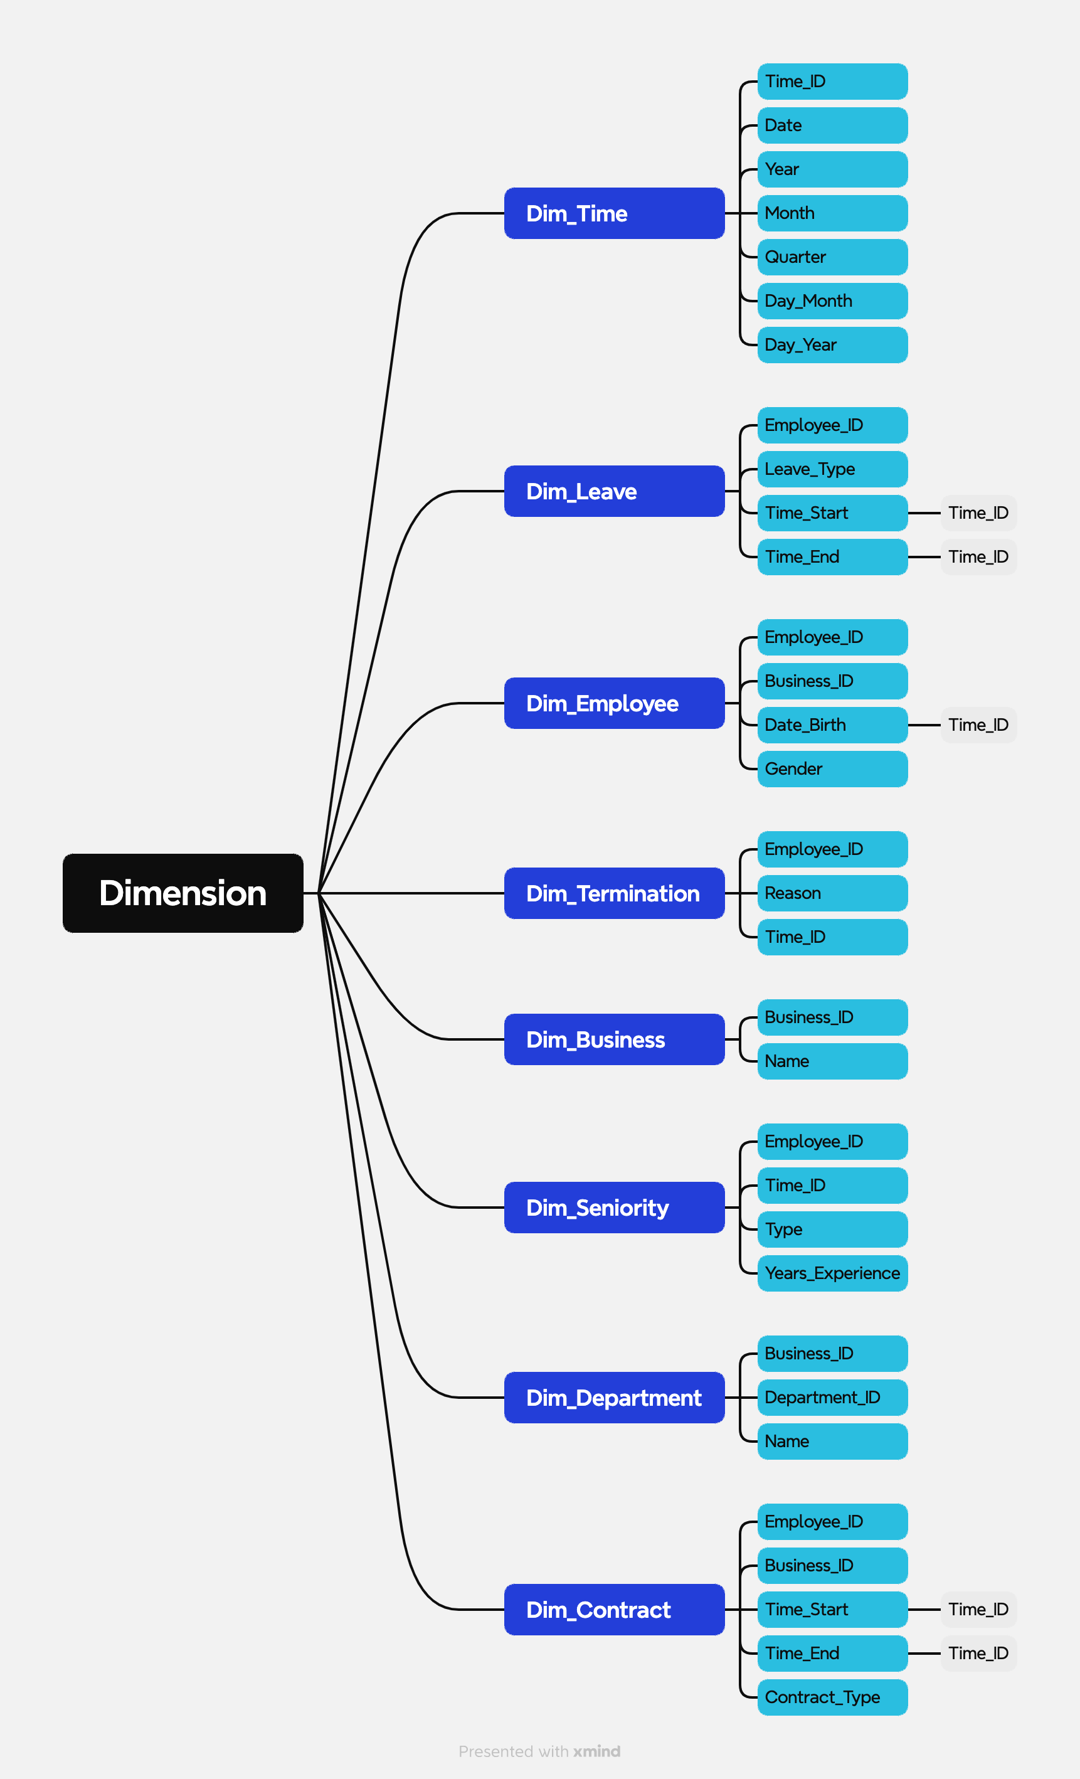
2. Database
https://xmind.app/m/wAK57Q
https://xmind.app/m/wAK57Q

Slide 6
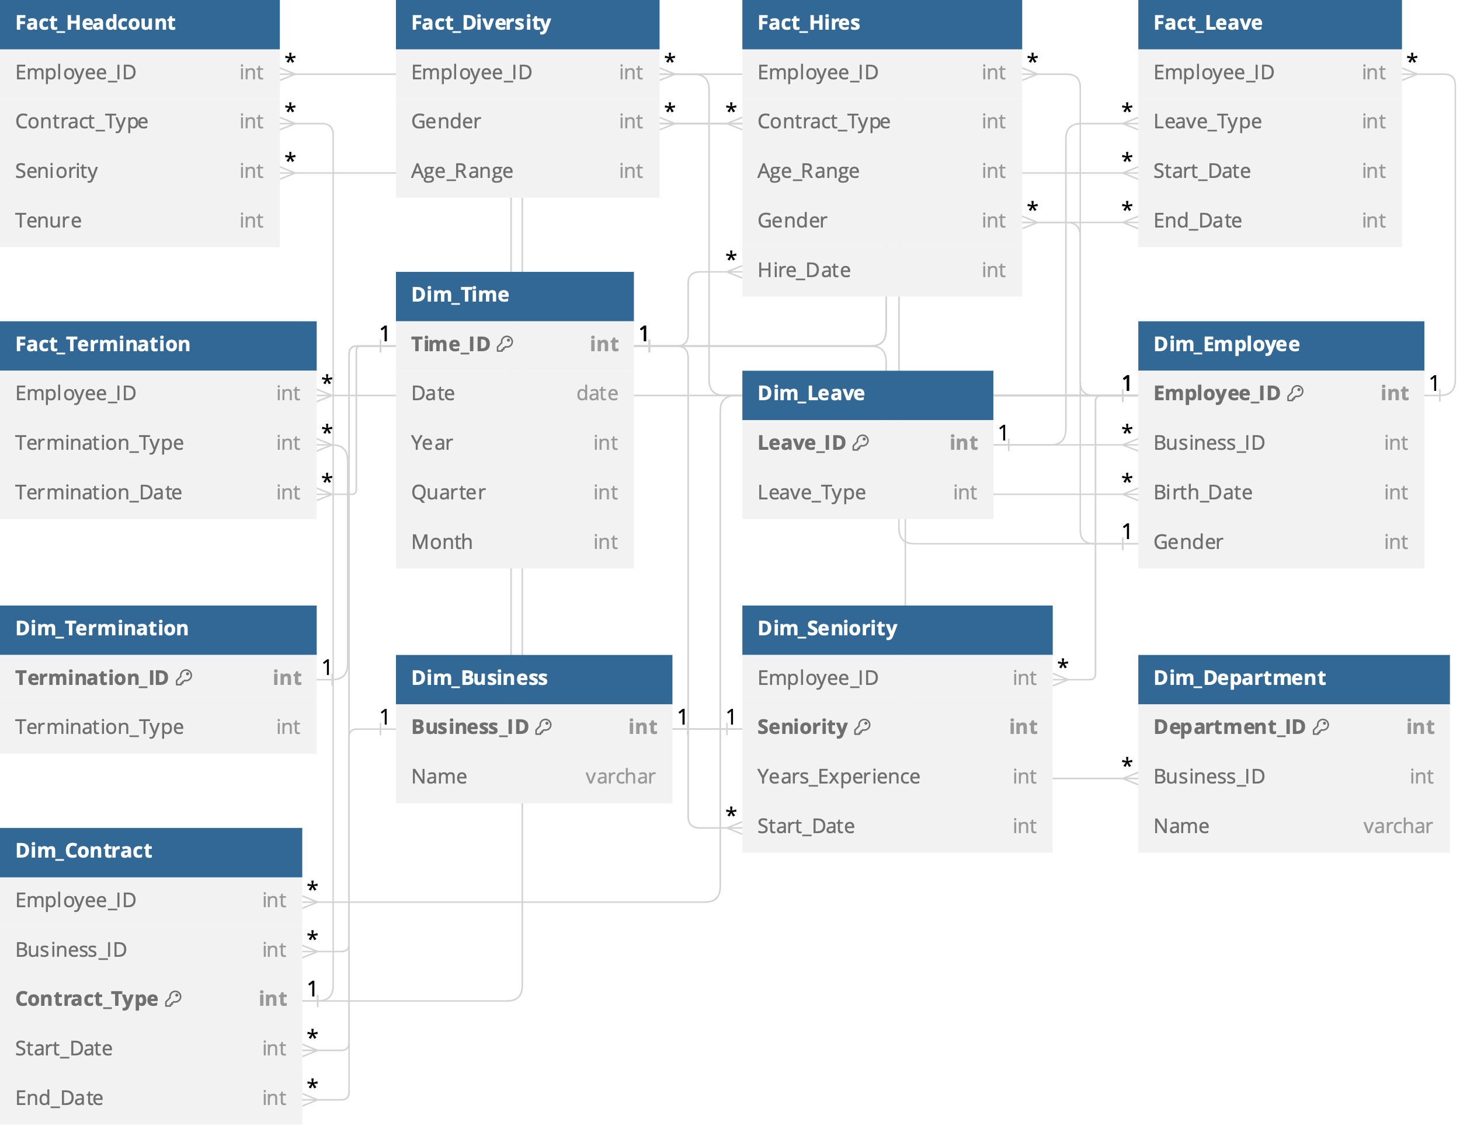
2. Database

Slide 7
3. Query
Headcount
SELECT Count(e.employee_id) AS total_employees FROM employee e left join contract c ON e.employee_id = c.employee_id WHERE <Date_Filter> BETWEEN c.start_date AND IF(c.end_date != null, c.end_date, Curdate())
Headcount by Contract Type
SELECT c.contract_type, COUNT(e.employee_id) AS total_employees FROM employee e LEFT JOIN contract c ON e.employee_id = c.employee_id WHERE <Date_Filter> BETWEEN c.start_date AND IF(c.end_date != NULL, c.end_date, Curdate()) GROUP BY c.contract_type;

Slide 8
3. Query
Headcout by Seniority
SELECT e.Seniority, COUNT(e.employee_id) AS total_employees FROM employee e LEFT JOIN contract c ON e.employee_id = c.employee_id WHERE <Date_Filter> BETWEEN c.start_date AND IF(c.end_date != NULL, c.end_date, Curdate()) GROUP BY e.Seniority;

Slide 9
3. Query
Average Tenure
SELECT AVG(e.employee_id) AS total_employees FROM employee e LEFT JOIN contract c ON e.employee_id = c.employee_id WHERE <Date_Filter> BETWEEN c.start_date AND IF(c.end_date != NULL, c.end_date, Curdate())

Slide 10
3. Query
Female %
SELECT COUNT(e.employee_id) AS total_employees_Female FROM employee e LEFT JOIN contract c ON e.employee_id = c.employee_id WHERE <Date_Filter> BETWEEN c.start_date AND IF(c.end_date != NULL,c.end_date,Curdate()) AND e.Gender = 'Female'

Slide 11
3. Query
Headcount by Gender
SELECT e.Gender, COUNT(e.employee_id) AS total_employees_Female FROM employee e LEFT JOIN contract c ON e.employee_id = c.employee_id WHERE <Date_Filter> BETWEEN c.start_date AND IF(c.end_date != NULL,c.end_date,Curdate()) GROUP BY e.Gender

Slide 12
3. Query
Headcount by Age Range
SELECT SUM(CASE WHEN TIMESTAMPDIFF(YEAR, Age_Range, CURDATE()) < 20 THEN 1 ELSE 0 END) AS total_employees_20, SUM(CASE WHEN TIMESTAMPDIFF(YEAR, Age_Range, CURDATE()) BETWEEN 20 AND 29 THEN 1 ELSE 0 END) AS total_employees_20_30, SUM(CASE WHEN TIMESTAMPDIFF(YEAR, Age_Range, CURDATE()) BETWEEN 30 AND 39 THEN 1 ELSE 0 END) AS total_employees_30_40, SUM(CASE WHEN TIMESTAMPDIFF(YEAR, Age_Range, CURDATE()) BETWEEN 40 AND 49 THEN 1 ELSE 0 END) AS total_employees_40_50, SUM(CASE WHEN TIMESTAMPDIFF(YEAR, Age_Range, CURDATE()) BETWEEN 50 AND 59 THEN 1 ELSE 0 END) AS total_employees_50_6, SUM(CASE WHEN TIMESTAMPDIFF(YEAR, Age_Range, CURDATE()) > 60 THEN 1 ELSE 0 END) AS total_employees_50_60 FROM Employee e LEFT JOIN Contract c ON e.Employee_ID = c.Employee_ID WHERE <date_filter> BETWEEN c.Start_Date AND IF(c.End_Date != NULL, c.End_Date, CURDATE())

